Slide 1
Deep Learning based biomarker analysis for COVID-19
Vedant Mahangade

Slide 2
Biomarkers

Slide 3
Biomarkers
Indicators of biological states or conditions
Early detection of severe cases
Monitoring disease progression
Identify potential targets for therapy

Slide 4
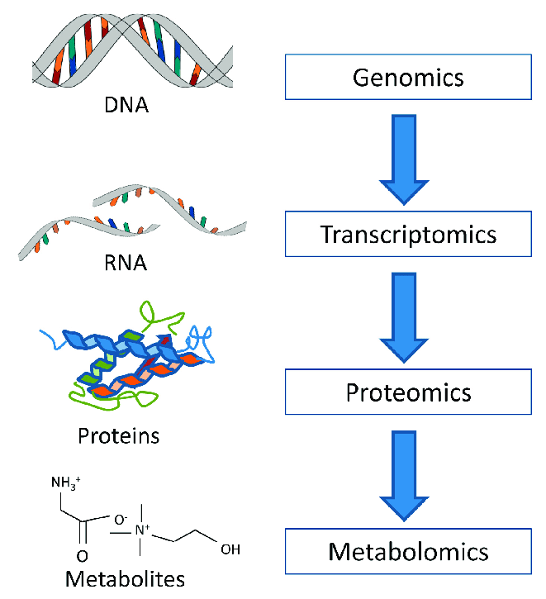
Biomarkers
Indicators of biological states or conditions
Early detection of severe cases
Monitoring disease progression
Identify potential targets for therapy

Slide 5
Biomarkers
Metabolites
Indicators of biological states or conditions
Early detection of severe cases
Monitoring disease progression
Identify potential targets for therapy
Small molecules (e.g., glucose, vitamins)
Involved in biochemical reactions
Infections correlates with metabolic changes

Slide 6
Are there alternative ways to do this?

Slide 7
Are there alternative ways to do this?
Yes

Slide 8
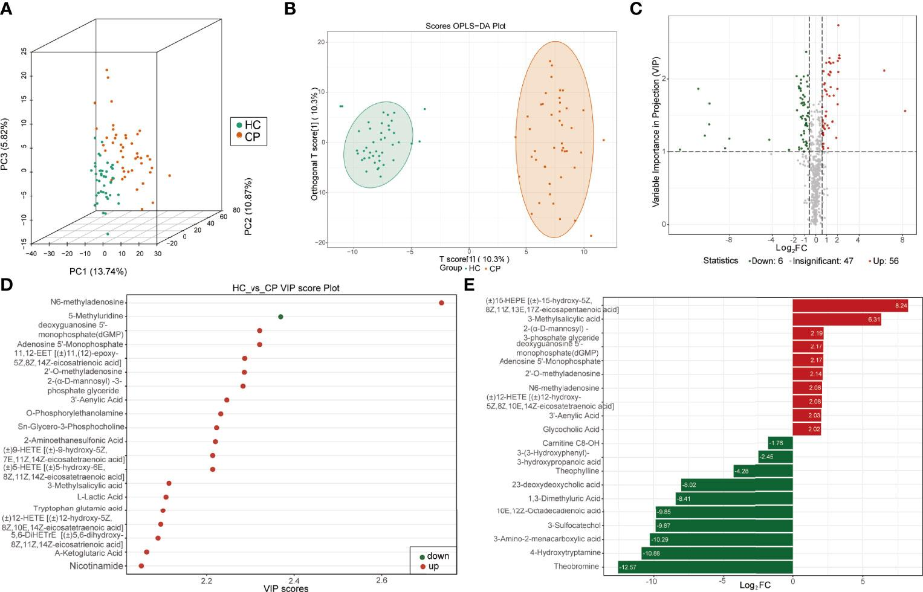
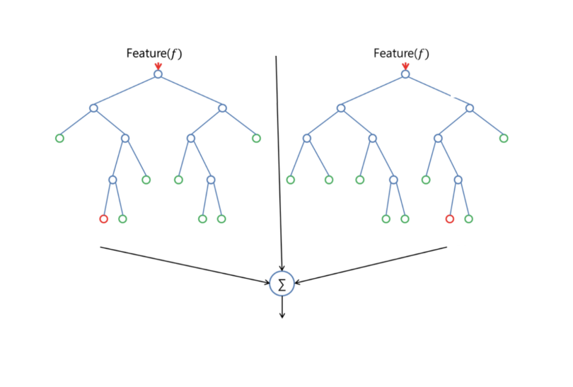
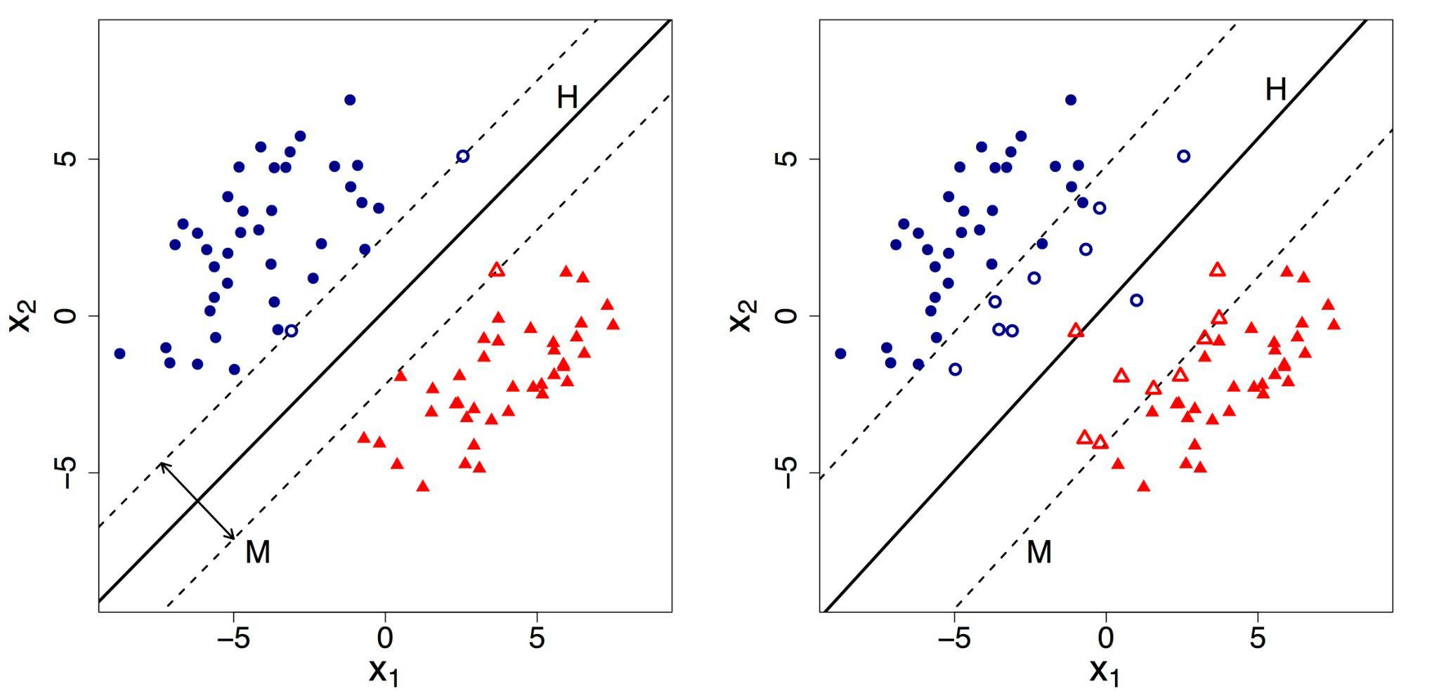
Are there alternative ways to do this?
Yes
Methods
PLS-DA
Random Forests
SVM

Slide 9

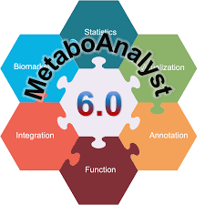
Are there alternative ways to do this?
Yes
Methods
Tools
PLS-DA
Random Forests
SVM

Slide 10
Why Deep Learning?

Slide 11
Why Deep Learning?
Metabolomics data has complex relationships
Deep Learning handles high-dimensional data effectively
Deep learning excels at:
Feature selection
Pattern recognition across groups
Provides insights into feature importance through explainability methods

Slide 12
Data Processing

Slide 13
Data Processing
Data Collection
Sourced data from two studies
Study 1: 108 samples, 110 metabolites
Study 2: 161 samples, 109 metabolites

Slide 14
Data Processing
Data Collection
Metabolite Name Mapping
Sourced data from two studies
Study 1: 108 samples, 110 metabolites
Study 2: 161 samples, 109 metabolites
Resolved inconsistencies in metabolite names
e.g., C4 in Study 1 ≈ Butyrylcarnitine in Study 2
Used The Human Metabolome Database (HMDB) for reference.

Slide 15
Data Processing
Data Collection
Metabolite Name Mapping
Data Integration
Sourced data from two studies
Study 1: 108 samples, 110 metabolites
Study 2: 161 samples, 109 metabolites
Resolved inconsistencies in metabolite names
e.g., C4 in Study 1 ≈ Butyrylcarnitine in Study 2
Used The Human Metabolome Database (HMDB) for reference.
Combined metabolite data with metadata.
Merged datasets into a unified format.

Slide 16
Data Processing
Data Collection
Metabolite Name Mapping
Data Integration
Missing Value Imputation
Sourced data from two studies
Study 1: 108 samples, 110 metabolites
Study 2: 161 samples, 109 metabolites
Resolved inconsistencies in metabolite names
e.g., C4 in Study 1 ≈ Butyrylcarnitine in Study 2
Used The Human Metabolome Database (HMDB) for reference.
Combined metabolite data with metadata.
Merged datasets into a unified format.
Categorical: Replaced missing values with mode.
Numerical: Replaced missing values with median.

Slide 17
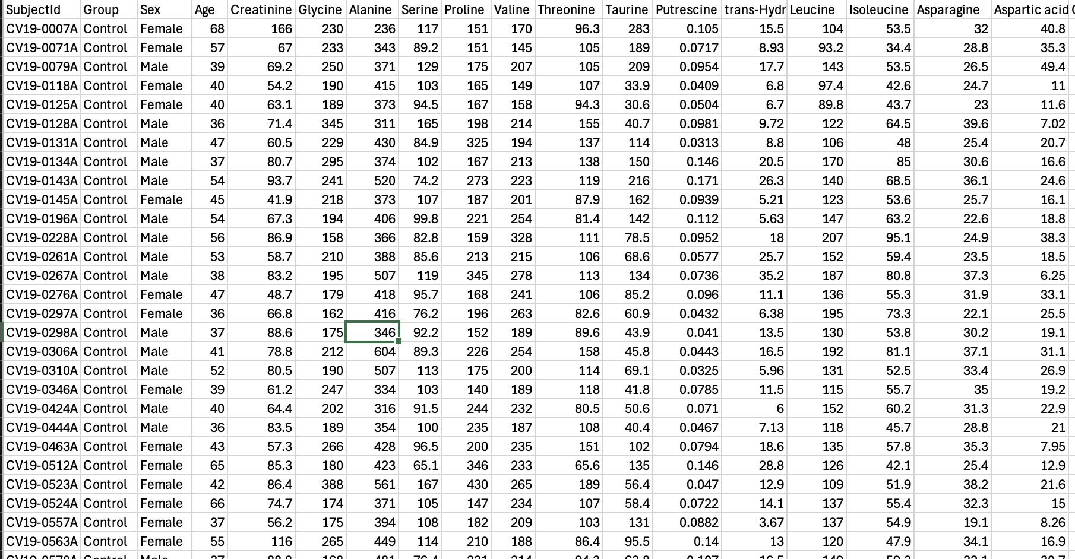
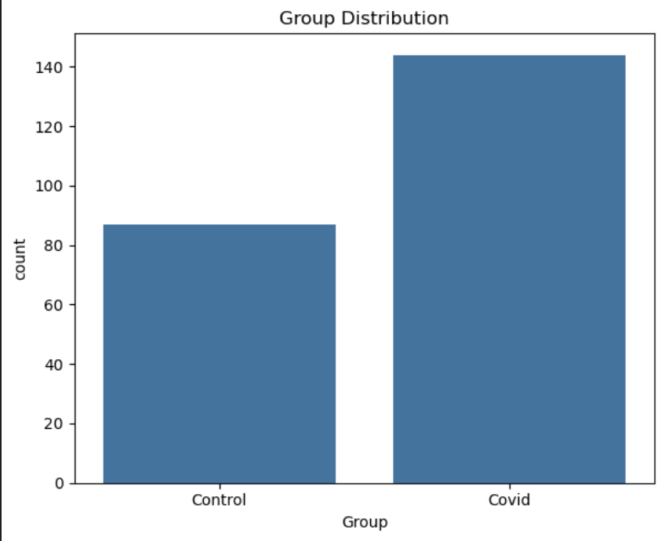
Metabolite data
107 Metabolites
144
87
Notes:
Values are metabolite count value also known as expression levels.
Based on the information in the referenced paper they are obtained from blood plasma.

Slide 18
Hybrid 1D CNN

Slide 19
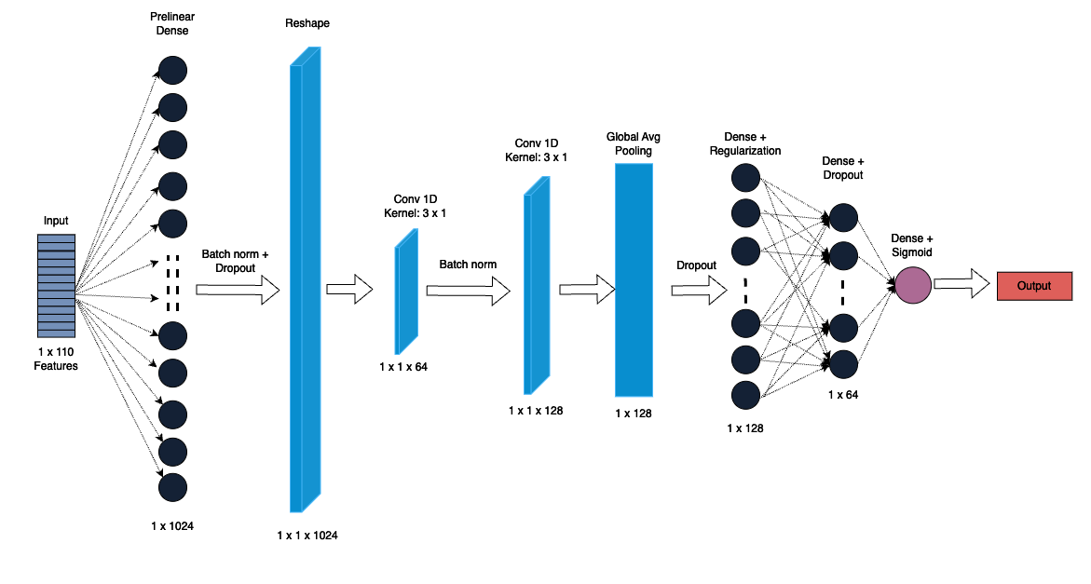
Hybrid 1D CNN
Handling tabular data:
Prelinear dense layer
Reshape layer
Handling Overfitting:
Dropout
L2 regularization
Class weights

Slide 20
Model Training
Loss Function: Binary Cross Entropy
Optimizer: Adam
Learning rate: 0.0001
Class weights: {0: 1.317, 1: 0.806}
Epochs: 88/400 (Early stopping)

Slide 21
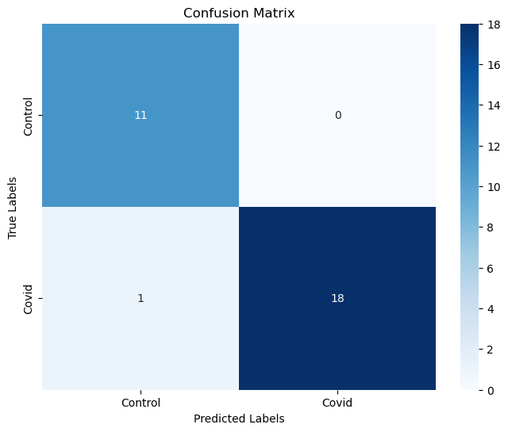
Model Training
Class | Precision | Recall | F1-Score
Control | 0.92 | 1.00 | 0.96
Covid | 1.00 | 0.95 | 0.97
Loss Function: Binary Cross Entropy
Optimizer: Adam
Learning rate: 0.0001
Class weights: {0: 1.317, 1: 0.806}
Epochs: 88/400 (Early stopping)

Slide 22
Results on Test
Notes:
Contained 15% of dataset
On best model obtained at epoch 88

Slide 23
Results on Test
Class | Precision | Recall | F1-Score
Control | 1.00 | 0.92 | 0.96
Covid | 0.96 | 1.00 | 0.98
Notes:
Contained 15% of dataset
On best model obtained at epoch 88

Slide 24
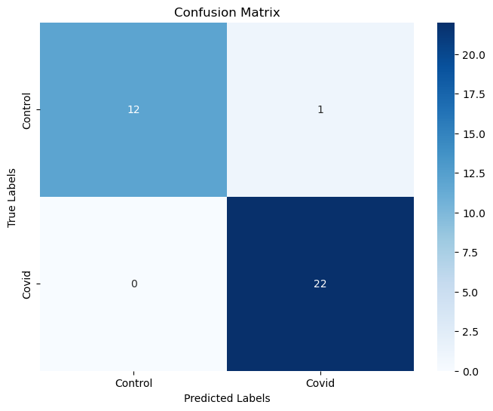
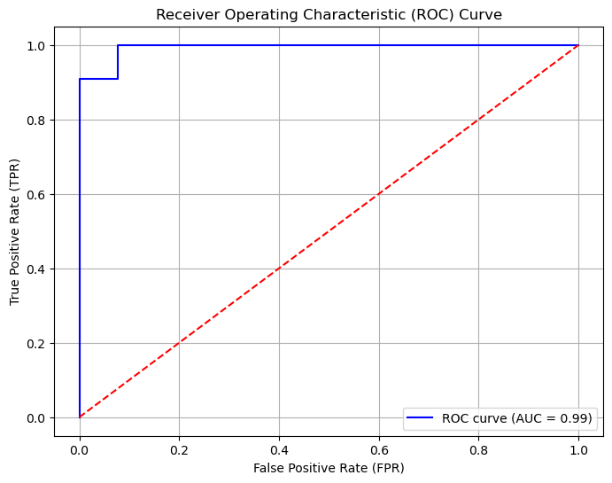
Results on Test
Class | Precision | Recall | F1-Score
Control | 1.00 | 0.92 | 0.96
Covid | 0.96 | 1.00 | 0.98
Notes:
Contained 15% of dataset
On best model obtained at epoch 88

Slide 25
Extracting Insights from the Model

Slide 26
Extracting Insights from the Model
SHAP: SHapley Additive exPlanations
Package which can be used to explain the output of any machine learning model
Permutation explainer
Randomly permutes feature values and measures the impact on model predictions
Computationally heavy than alternative SHAP explainers
Useful when the relationship between features and predictions is complex or non-linear

Slide 27
Extracting Insights from the Model
SHAP: SHapley Additive exPlanations
Package which can be used to explain the output of any machine learning model
Permutation explainer
Randomly permutes feature values and measures the impact on model predictions
Computationally heavy than alternative SHAP explainers
Useful when the relationship between features and predictions is complex or non-linear
Model +
Test data
Permutation Explainer
Shapley Values
(35, 110, 2)
Mean across samples
Mean Values
(110, 2)
Max from 2 Classes
Aggregate Values
(110)

Slide 28
Top Features

Slide 29
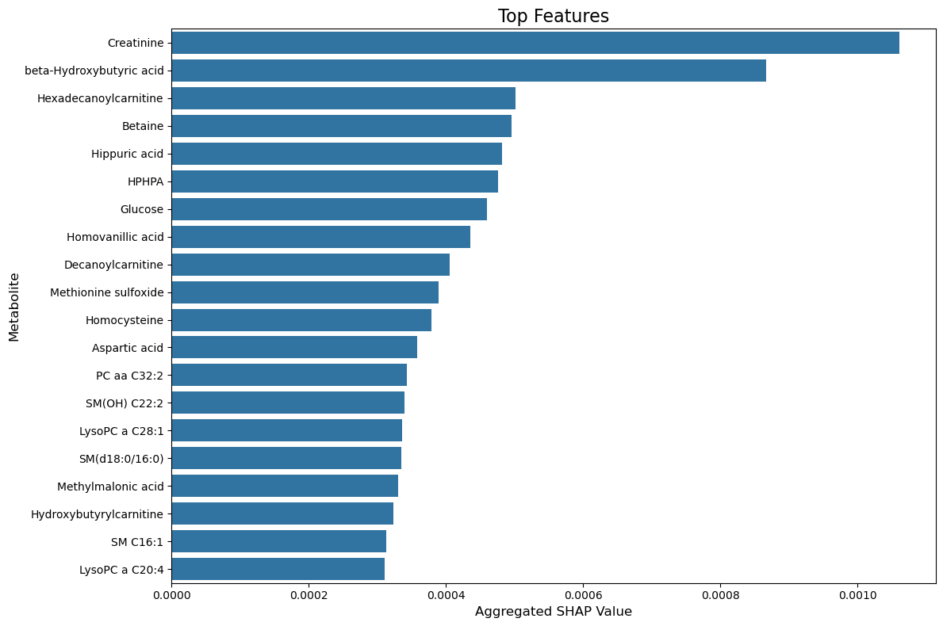
Top Features

Slide 30
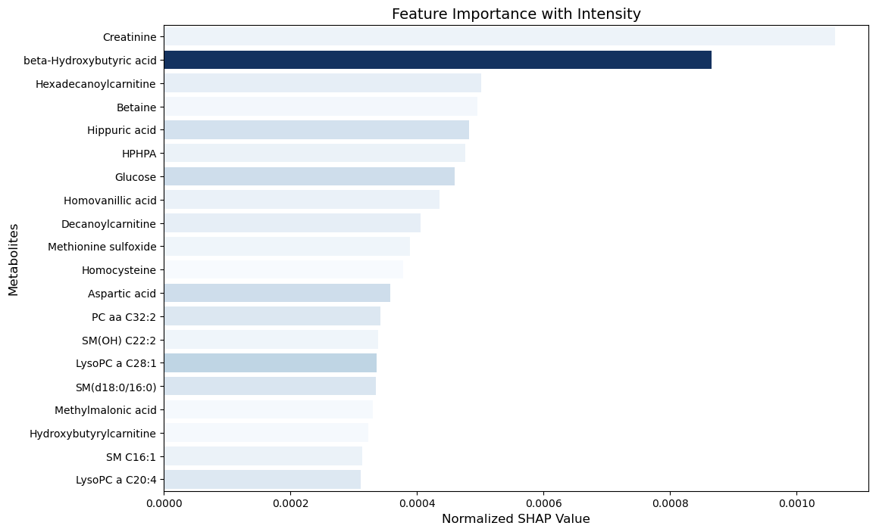
Top Features

Slide 31
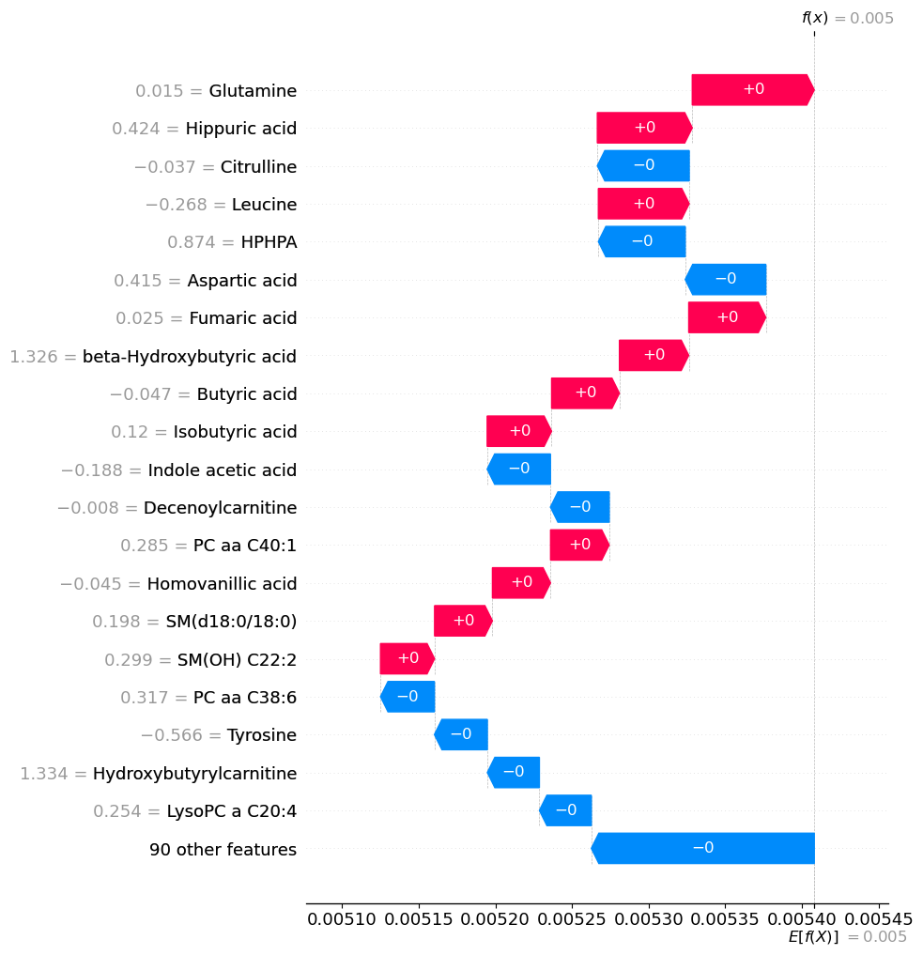
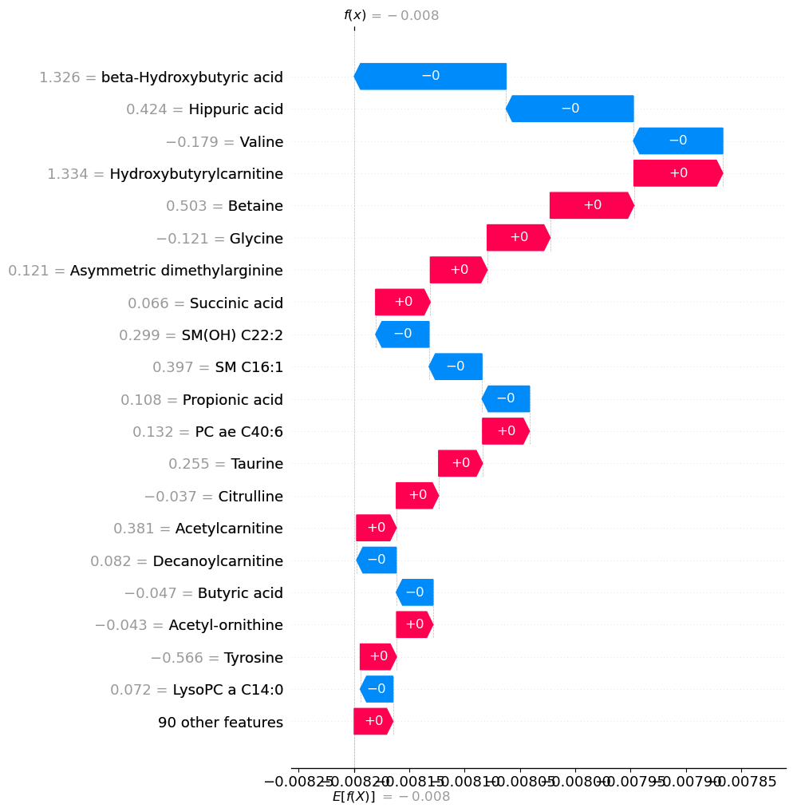
High Impact Metabolites for Control
High Impact Metabolites for Covid

Slide 32
Case vs Control
Notes:
Biomarkers here are those which have high absolute mean SHAP value for Covid but not for Control
Metabolites were ranked by the absolute difference in mean SHAP values between the "COVID" and "Control" groups

Slide 33
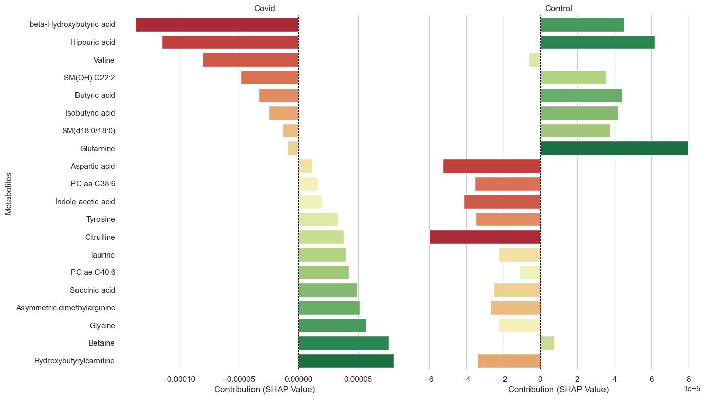
Case vs Control

Slide 34
Case vs Control

Slide 35
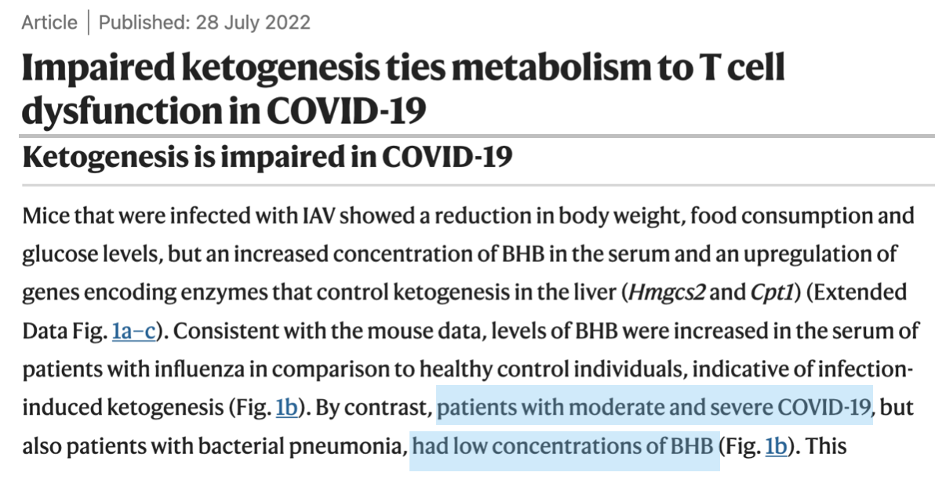
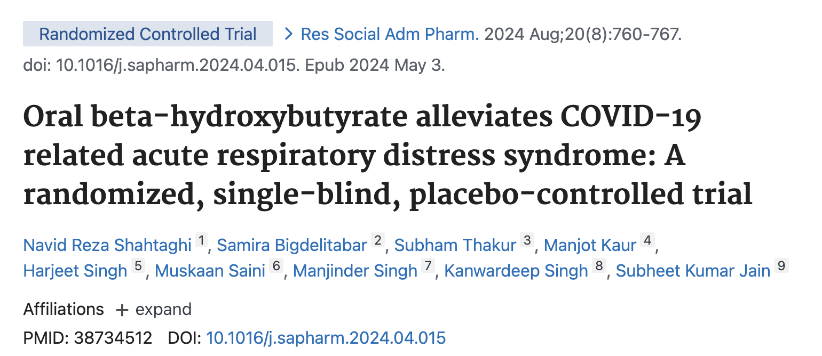
Interesting Ones

Slide 36
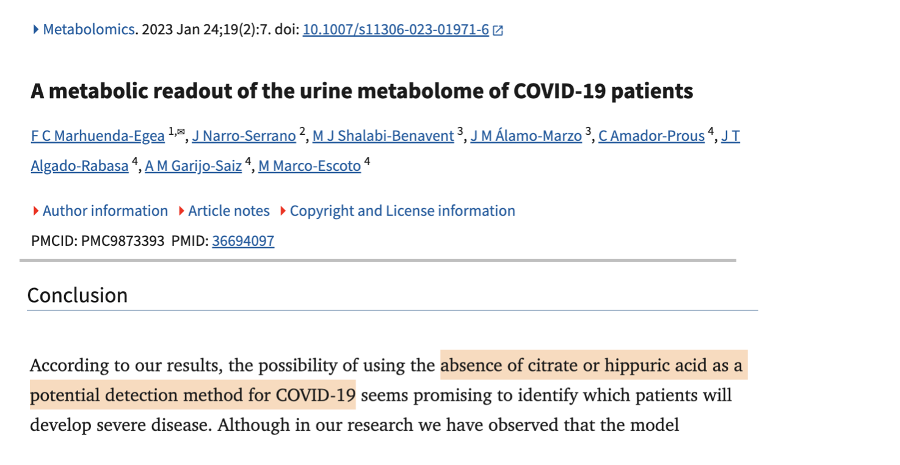
Interesting Ones

Slide 37
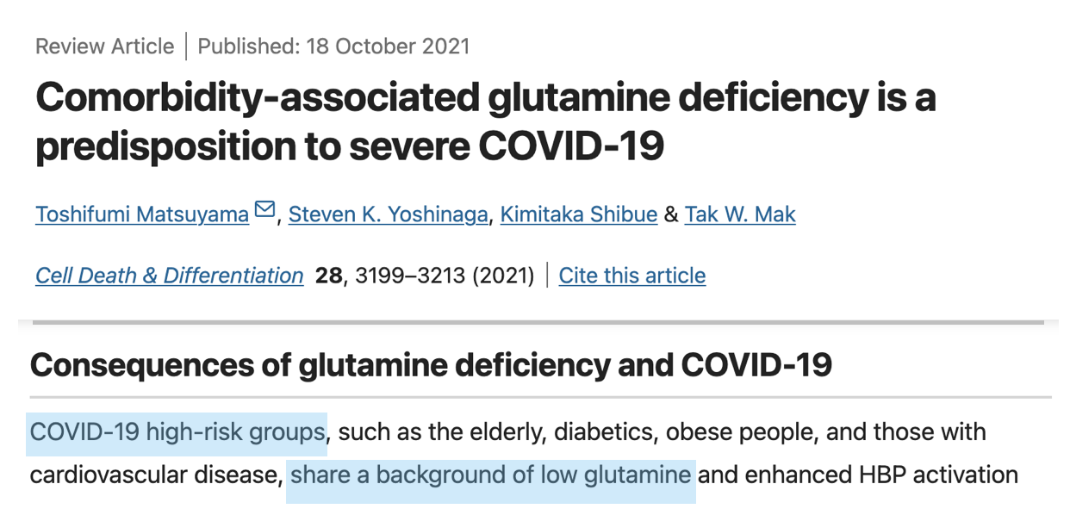
Interesting Ones

Slide 38
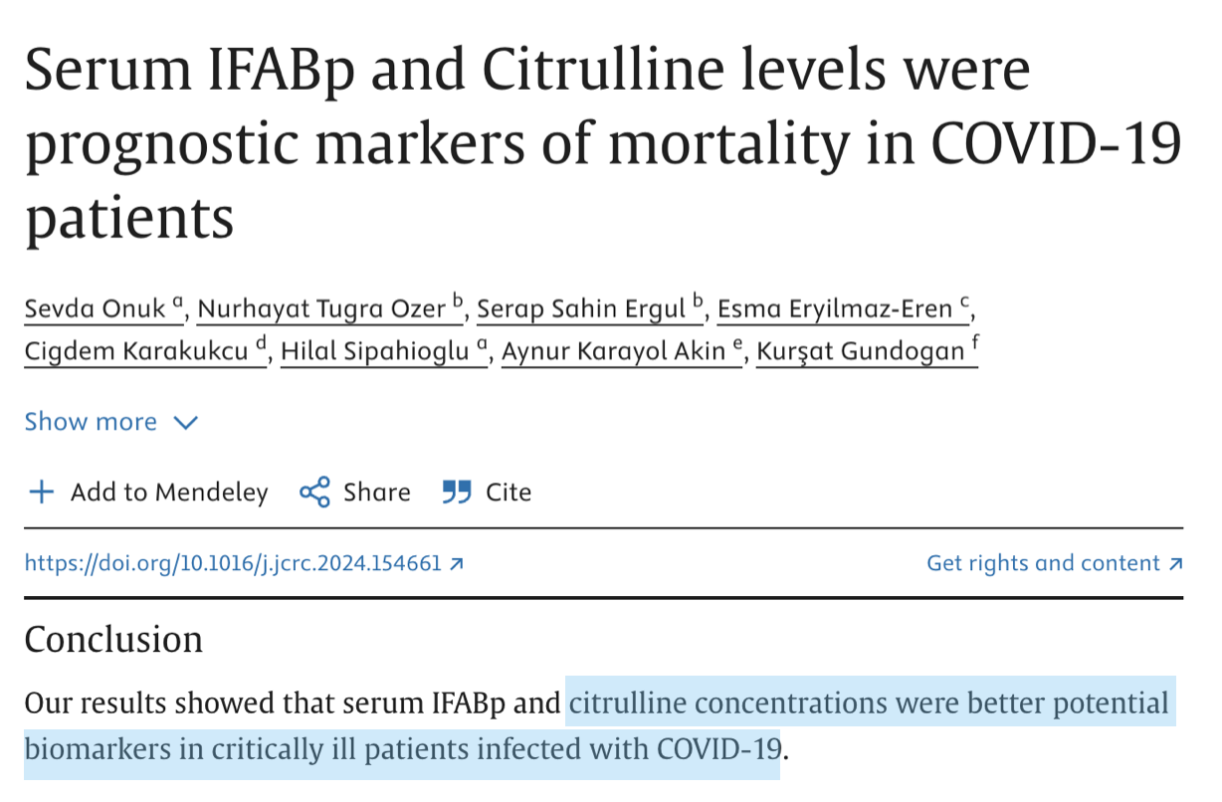
Interesting Ones

Slide 39
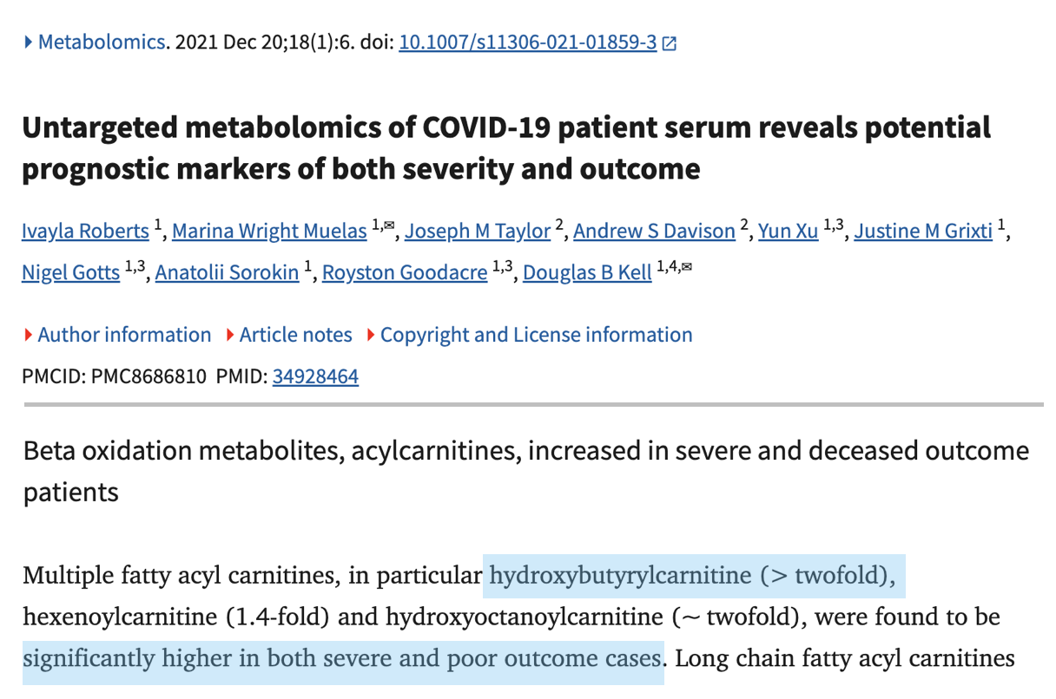
Interesting Ones

Slide 40
What further analysis can be done?
Identify exactly how these metabolites affect the body (pathway enrichment analysis)
Identify the threshold / cutoff for these biomarkers for diagnostic purposes.
Identify if any of these biomarkers could lead to potential treatments.

Slide 41
Questions?

